Slide 1
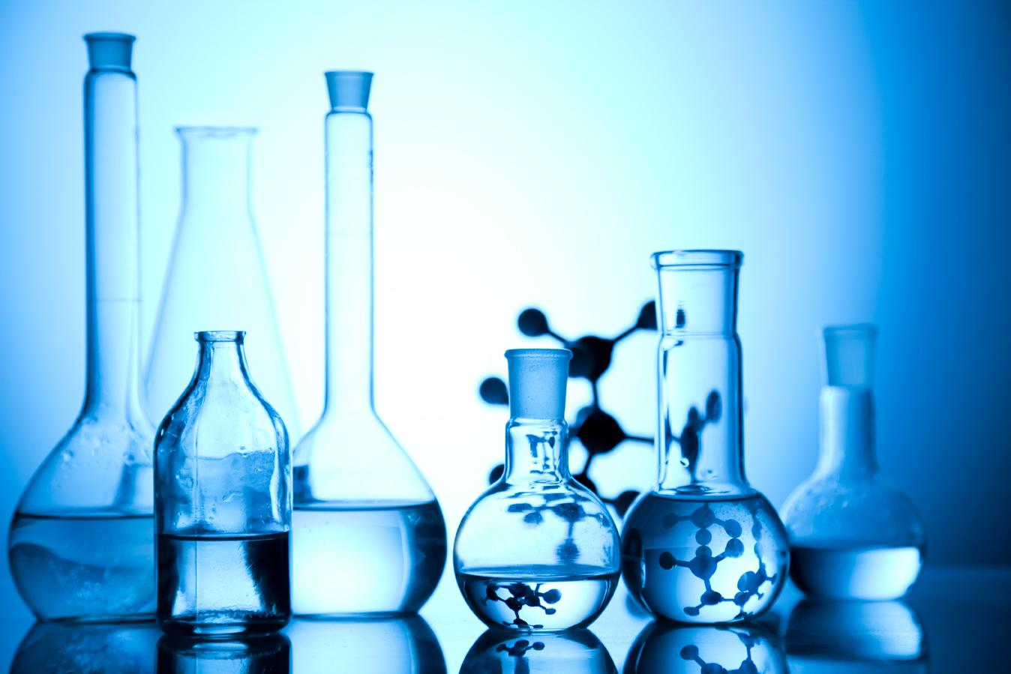

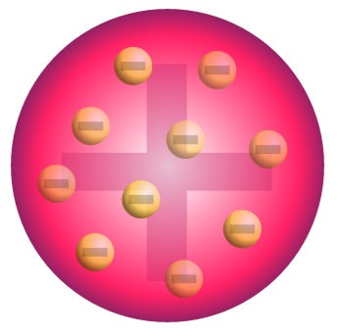
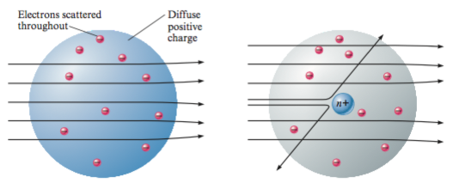
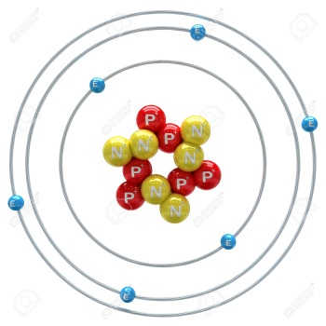
STRUCTURE OF THE ATOM

Slide 2

MODULE : 1
Introduction & activity

Slide 3

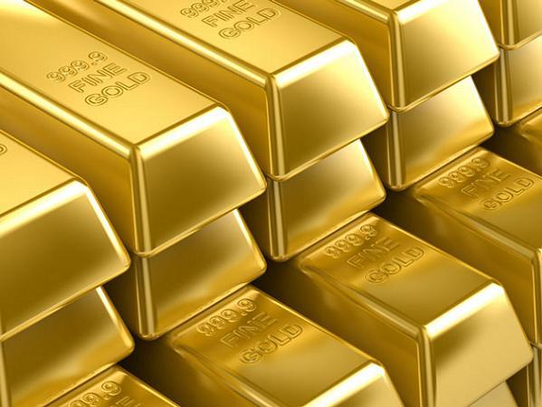
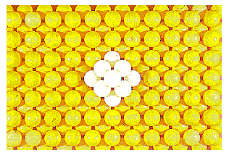
We have learnt that atoms and molecules are the
fundamental building blocks of matter
Are atoms really
indivisible?
gold
What makes the atom
of one element different
from the atom of
another element?
Gold foil
Atoms of gold
We shall find out the
answers to these
questions in this
chapter

Slide 4



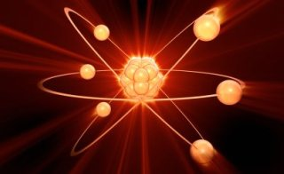




A
C
T
I
V
I
T
Y
Rub a glass rod with a silk cloth
and bring the rod near an inflated
balloon. Glass rod attract the
balloon.
Comb dry hair. Does the comb
then attract small pieces of
paper?
Comb
dry
hair
Balloon
From these activities, can we
conclude that on rubbing two
objects together, They become
electrically charged.
We know that an electrically
charged object can attract an
uncharged object.
Within the atoms present in the
comb and glass rod.
Where does this charge
come from??
Observed what happens??
So, The atom is divisible.
Silk cloth
Glass
rod
These simple experiments tell us
that some charged particles are present in the atoms of matter.
Comb
Small pieces
Of paper

Slide 5
MODULE : 2
Discovery of Electrons & Thomson's atomic model

Slide 6
Many scientists contributed in revealing the presence
of charged particles in an atom.
Discovery of sub-atomic
particles
It was known by 1900 that the atom
was not a simple, indivisible particles
but Contained at least one
sub - atomic particles.

Slide 7
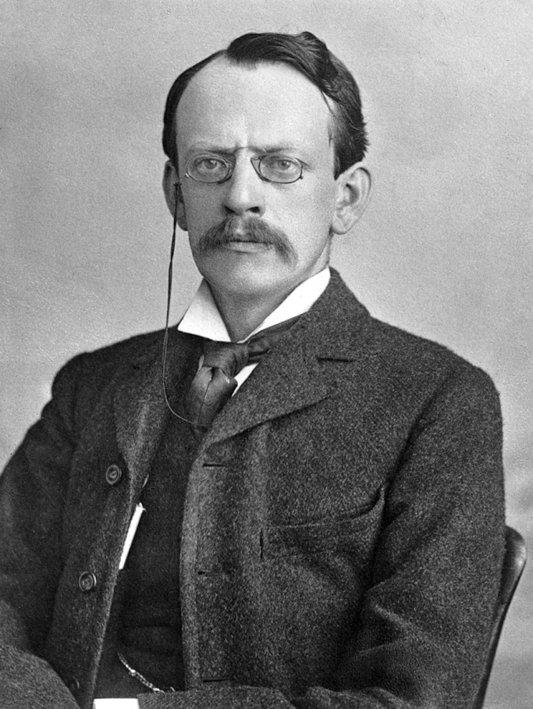

He directed the Cavendish Laboratory at Cambridge for 35 years and seven of his research assistants subsequently won Nobel prizes.
He was awarded the Nobel prize in physics for his work on the discovery of electrons.
J.J Thomson
(1856-1940)
A British physicist was born in Cheetham Hill,
a suburb of Manchester, on 18 December 1856.

Slide 8

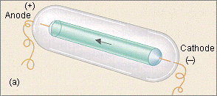
Thomson’s
Atomic
Model
Negative
electrode
Thomson passed electricity at high voltage through a gas at very
low pressure taken in a discharge tube.
Streams of minute particles were given out by the cathode.
These streams of particles are called cathode rays.
Because they
come out of
Cathode
Cathode rays consist of small negatively charged particles called
electrons.
Since all the gases form cathode rays it was concluded that all the
atoms contain negatively charged particles called electrons.

Slide 9
MODULE : 3
Canal rays, protons & characteristics

Slide 10
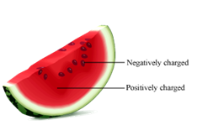
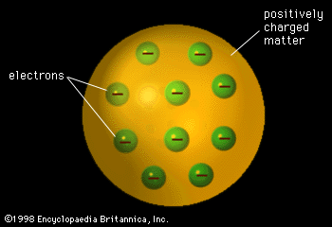
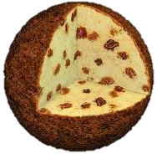
Thomson proposed the model of an atom to be similar to that of a Christmas pudding.
The electrons , in a sphere of positive charge. Were like a currants
(dry fruits) in a spherical Christmas pudding.
While the electrons are studded in the positively charged sphere, like the seeds in the watermelon.

Slide 11


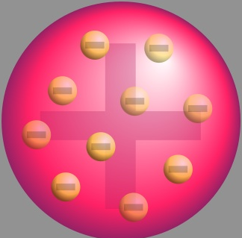
Thomson proposed that:
Positive charge
Negative charge
Electron
i) An atom consists of a positively charged sphere and the electrons
are embedded in it.
ii) The negative and positive charges are equal in magnitude. So, the
atom as a whole is electrically
Neutral.
No charge

Slide 12
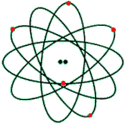
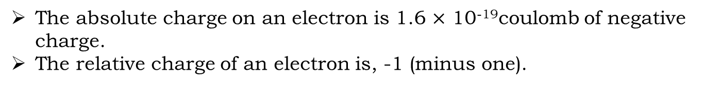
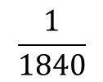
Characteristics of an Electron
Mass of an Electron
$$\frac{1}{1840}$$
The mass of an electron is about of the
mass of hydrogen atom
The mass of an electron is so small that it is
considered to be negligible.
Charge of an Electron
The absolute charge on an electron is 1.6 $×$ 10⁻¹⁹coulomb of negative charge.
The relative charge of an electron is, -1 (minus one).

Slide 13
MODULE : 4
Rutherford's gold foil experiment & drawback

Slide 14
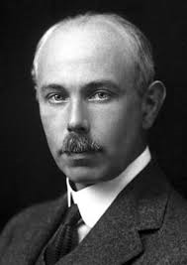
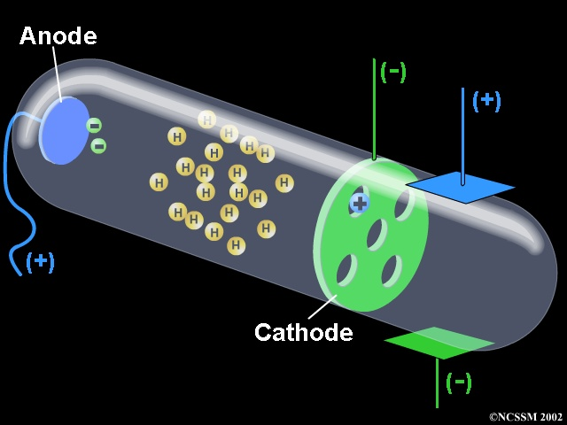
E. Goldstein discovered the presence of new radiations in a gas Discharge and called them canal rays.
These rays were positively charged radiations.
This sub-atomic particle had a
charge, equal in magnitude but
opposite in sign to that of the
electron.
Its mass was approximately 2000
times as that of the electron.
It was given the name of
proton.
Which is represented
as ‘p’

Slide 15
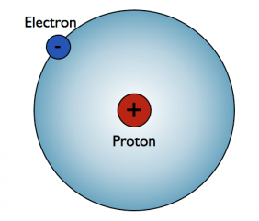
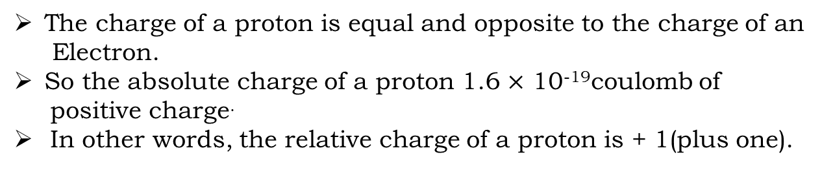
Characteristics of a proton
The two important characteristics of a proton
are its mass and charge.
Mass of a proton
The proton is actually a hydrogen atom
which has lost its electron.
The relative mass of a proton is 1 u.
Charge of a proton
The charge of a proton is equal and opposite to the charge of an
Electron.
So the absolute charge of a proton 1.6 $×$ 10⁻¹⁹coulomb of
positive charge.
In other words, the relative charge of a proton is + 1(plus one).

Slide 16
MODULE : 5
Neils Bohr's atomic model & electronic configuration

Slide 17
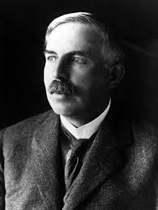
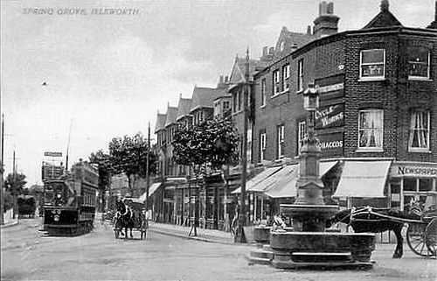
Was born at spring Grove on 30 August 1871.
He was known as the ‘Father’ of nuclear physics.
He is famous for his work on radioactivity and the discovery of the nucleus of an atom with the gold foil experiment.
He got the Nobel prize in Chemistry in 1908.
E. Rutherford
(1871-1937)

Slide 18
RUTHERFORD’S
Model of
an Atom
Alpha particles is a positively
charged particle having
2 units of positive charge
& 4 units of mass
Ernest Rutherford was interested in knowing how the electrons are
arranged within an atom.
Rutherford designed an experiment for this.
In this experiment, fast moving alpha ($∝$) – particles were made to
fall on a thin gold foil

Slide 19

GOLD FOIL EXPERIMENT
In front of the source keep a thin gold foil
Keep screens to detect the alpha rays
gold foil
Take a source of alpha rays
Thin sheet made up of gold
They are beam of positively charged particle

Slide 20





Stand near a fence and throw a stone towards the fence.
GOLD FOIL EXPERIMENT
The first ray passes through the gold sheet
Let’s see the
reason behind
this by performing
a simple experiment

Slide 21
GOLD FOIL EXPERIMENT
The first ray passes through the gold sheet

Slide 22
GOLD FOIL EXPERIMENT
The first ray passes through the gold sheet

Slide 23



GOLD FOIL EXPERIMENT
The stone passes through the fence to the other side.
The first ray passes through the gold sheet
Why does this happens???
There is a lot of empty space between the two planks of the fence. Hence, the stone passes through the fence.
Similarly in the gold atom there is a lot of empty space from where the alpha rays passes.

Slide 24
GOLD FOIL EXPERIMENT
The second ray hits the gold foil and turns back
Let’s see the reason behind this.

Slide 25
GOLD FOIL EXPERIMENT
The second ray hits the gold foil and turns back

Slide 26
GOLD FOIL EXPERIMENT
The second ray hits the gold foil and turns back

Slide 27
GOLD FOIL EXPERIMENT
The 2nd stone hits the fence and turns back
The second ray hits the gold foil and turns back
This happens because the stone hits the plank and doesn’t allow the stone to pass through.
Similarly in the gold atom there is a positively charged part which turns the positively charged alpha rays.
Why does this happens???

Slide 28
GOLD FOIL EXPERIMENT
Majority of the rays passes through the gold sheet, this shows that the part from which the positively charged alpha rays turns back is very small in size compared to the empty space.

Slide 29



Conclusion of Rutherford’s alpha- particle scattering experiment show
the presence of a nucleus in the atom.
It also given the following important information about the nucleus
of an atom:
Nucleus of an atom is positively charged.
Nucleus of an atom is very dense and hard.
Nucleus of an atom is very small as compared
to the size of the atom as a whole.
The relative size of the nucleus
in an atom is roughly the same
As that of a pea in the middle of
this large stadium.
The radius of nucleus has been
found to be about 10 times
smaller than the radius of
the atom.
5

Slide 30
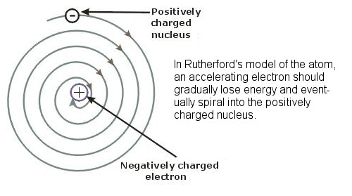
Drawback of Rutherford’s Model of the Atom
A major drawback (or defect) of Rutherford’s model of the atom is that it does not explain the stability of the atom.
Negatively
charged
electron
Any particle in a circular orbit would
undergo acceleration.
During acceleration, charged particles
would radiate energy.
Thus, the revolving electron would lose
energy and finally fall into the nucleus.
Positively
charged
nucleus
If this were so, the atom should be highly
unstable and hence matter would not exist
in the form that we know.
We know that atoms
are quite stable.

Slide 31
MODULE : 6
Electronic Configuration of first 18 elements

Slide 32
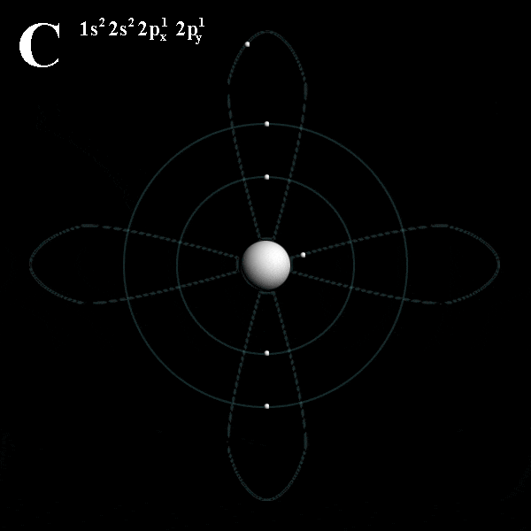
Neils Bohr Explained the stability of Atom
In order to explain the stability of atom and overcome the objection
against Rutherford’s model of atom, Neils Bohr gave a new arrangement of electrons in the atom in 1913.

Slide 33
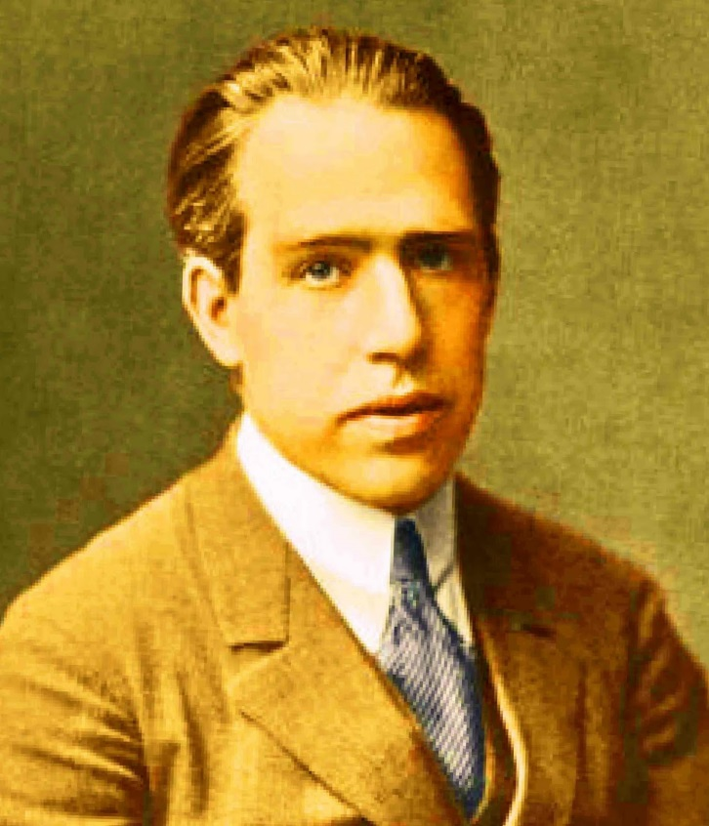

He got the Nobel prize for his work on the
structure of atom in 1922.
i) The Theory of Spectra and Atomic Constitution.
ii) Atomic Theory and
iii) The Description of nature.
Neils Bohr
(1855-1962)
He was appointed professor of physics at Copenhagen University 1916.
Was born in Copenhagen on 7 October 1885.
Among the Professor Bohr’s numerous writings,
Three appearing as books are

Slide 34

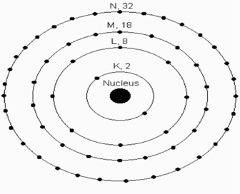
BOHR’S MODEL OF ATOM
Only certain special orbits
known as discrete orbits
of electrons, are allowed
inside the atom.
In order to overcome the objections raised against Rutherford’s model of the atom, Neils Bohr put forward the following postulates about the
model of an atom:
2. While revolving in discrete
orbits the electrons do not
radiate energy.
These orbits or shells are
represented by the letters
K,L,M,N,… or the
numbers, n = 1,2,3,4,…
These orbits or shell are
called energy level.

Slide 35




There is a limit to the number of
electrons which is energy level
(or shell) can hold
The maximum number of electrons which
can be accommodated in any energy level
of the atom is given by 2n² (where n is the
number of that energy level).
N=32
M=18
L=8
K= 2
2
K shell 2n = 2$×(1)$ = 2
2
2
Nucleus
L shell = 2$(2)$ = 8
2
M shell = 2$(3)$ = 18
2
N shell = 2$(4)$ = 32

Slide 36
MODULE : 7
Discovery of Neutrons & characteristics

Slide 37
Composition of Atoms of the first Eighteen Elements
with Electron Distribution in Various Shells
The number of protons in one atom of an element is
known as atomic number of that element.
Name of
Element
Atomic
Number
Distribution
of Electrons
Symbol
Hydrogen
H
1
(1)
H
Helium
He
2
(2)
He
Lithium
Li
3
(2,1)
Li
Beryllium
Be
4
(2,2)
Be
Boron
B
5
(2,3)
B
Carbon
C
6
(2,4)
C
Nitrogen
N
7
(2,5)
N
Oxygen
O
8
(2,6)
O

Slide 38
Name of
Element
Atomic
Number
Distribution
of Electrons
Symbol
Fluorine
F
9
(2,7)
Neon
Ne
10
(2,8)
F
Sodium
Na
11
(2,8,1)
Ne
Magnesium
Mg
12
(2,8,2)
Na
Mg
Aluminium
Al
13
(2,8,3)
Al
Silicon
Si
14
(2,8,4)
Phosphorus
P
15
(2,8,5)
Si
Sulphur
S
16
(2,8,6)
P
Chlorine
Cl
17
(2,8,7)
S
Argon
Ar
18
(2,8,8)
Cl
Ar

Slide 39
MODULE : 8
Atomic number & Mass number

Slide 40
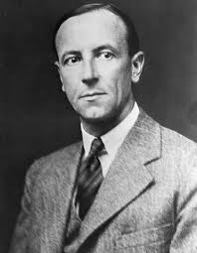

Chadwick was born in Bolington,Cheshire,
on 20 October 1891
In general, a neutron is represent as ‘n’ the mass of an atom is therefore given by the sum of the masses of protons and neutrons present in the nucleus.
In 1932, J. Chadwick discovered another sub-atomic particle which had no charge and a mass nearly equal to that of a proton.
It was eventually named as neutron. Neutrons are present in the nucleus of all atoms, except hydrogen.
J. Chadwick
1891-1974

Slide 41
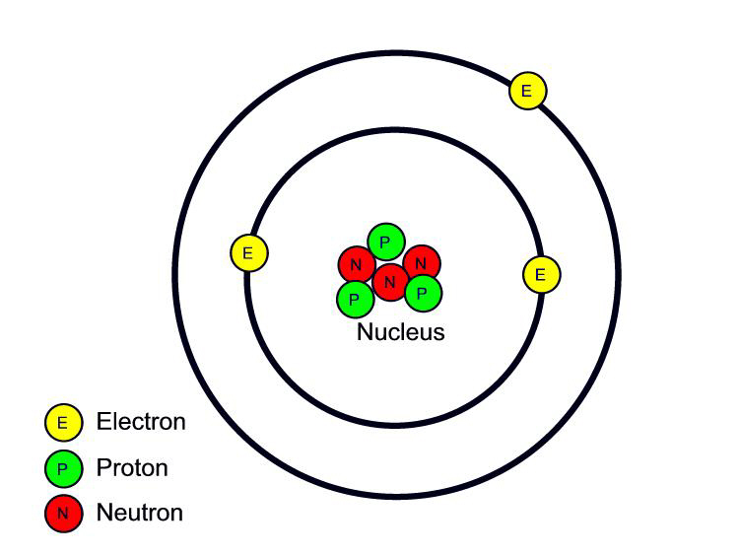
Characteristics of Neutron
Mass of Neutrons
The mass of neutrons is equal to the
mass of a proton. The relative mass
of a neutrons is 1 u.
Charge of Neutrons
Neutron has no charge. It is
electrically neutral.

Slide 42
MODULE : 9
Numericals based on atomic number and mass number

Slide 43
Atomic Number and Mass Number
The atomic number
of carbon is 6, so for
carbon, Z=6.
It is the number of a protons of an atom, which determines its atomic number. It is denoted by ’Z’ all atoms.
Atomic Number
Atomic number tell
us that it is carbon
element.
All the atoms of the same element have the
same number of protons in their nuclei, and
hence they have the same atomic number.
No other element
can have atomic
number 6.
No two elements can have the same atomic
number
In a normal atom (or neutral atom), the number of protons is equal to the number
of electrons in it.
So we can also say that the
Atomic number of an element
Is equal to the number of
electrons in a neutral
Atom.
Atomic number can be used to identify an element.

Slide 44

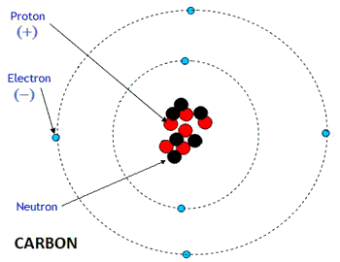
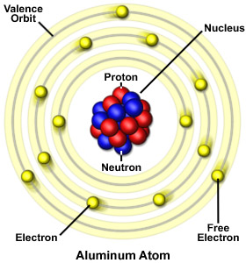
Mass Number
Mass of an atom
is practically due
to protons and
neutrons alone.
These are present
in the nucleus of
an atoms.
Hence protons and
neutrons are also
called nucleons.
For example, mass of carbons is 12 u because it has 6 protons and 6 neutrons, 6 u + 6u = 12u.
Similar, the mass
of aluminium is 27u
(13 protons + 14 neutrons).

Slide 45
The mass number of an
element is denoted by
the letter A
Mass Number
The mass number is defined as
the sum of the total number of
protons and neutrons present
in the nucleus of an atom.
In the notation for an atom,
the atomic number, mass
number and symbol of the
element are to be written as.
Mass
number
A
Z
X
Symbol
of
element
Atomic
number
14
For example, nitrogen is written as
N.
7

Slide 46
Relationship Between Mass Number and Atomic Number
Mass number = No. of protons + No. of neutrons
Since the number of
protons in an atom is
equal to the atomic
number of the element.
We can rewrite the above
relation by putting
“Atomic number” in
place of “No of Protons”
Mass number = Atomic number + No. of neutrons

Slide 47
MODULE : 10
Isotopes & different examples (Hydrogen)

Slide 48
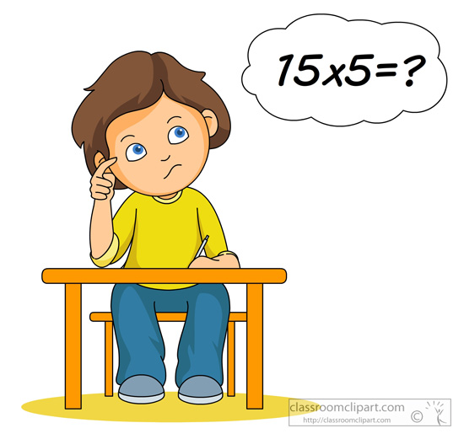
Sample problem 1.
Calculate the atomic number of an element whose atomic nucleus has
Mass number 23 and neutron number 12. what is the symbol of the
element?
Solution
We know that:
Mass number = Atomic number + No. of neutrons
23 = Atomic number + 12
Atomic number = 23 - 12
= 11
The element having atomic number 11 is sodium and its symbol is Na.
If, however, we indicate the atomic number and mass number also, then
the symbol become Na, where 11 is the atomic number and 23 is the
mass number.
23
11

Slide 49

Helium atom has an atomic mass of 4 u and 2 protons in
its nucleus. How many neutrons does it have?
Solution
We know that atomic mass is numerically equal to mass number of an atom. Since the helium atom has an atomic mass 4 u, therefore, the mass number of helium atom will be 4. and the number of proton in the
helium nucleus has been given to be 2. Now,
Mass number = No. of protons + No. of neutrons
4 = 2 + No. of neutrons
no. of neutrons = 4 - 2
= 2
Thus, the helium atom has 2 neutrons.

Slide 50
MODULE : 11
Isotopes of Carbon, Oxygen & Neon

Slide 51
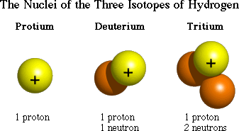
ISOTOPES
Eg:-
Hydrogen
Protium
Z=1
A=1
Deuterium
Z=1
A=2
``
Tritium
Z=1
A=3
ISOTOPES are the atoms
of the same element having same Atomic number but
different Atomic mass
number.

Slide 52
Examples
ELEMENT | MASS NUMBER (A) | ATOMIC NUMBER (Z) | NUMBER OF NEUTRON (N)
¹²
12
6
6
₆
C
¹⁴
14
6
8
₆
C
ELEMENT | MASS NUMBER (A) | ATOMIC NUMBER (Z) | NUMBER OF NEUTRON (N)
³⁵
Cl
35
17
18
₁₇
³⁷
Cl
37
17
20
₁₇
Number of neutrons in isotopes is different
Chemical properties of isotopes are the same.

Slide 53
The diagrams of the two isotopes of chlorine are given below:
-
-
e
-
e
Nucleus contains 17
protons
and 18 neutrons
e
-
-
e
e
-
e
17p+
18n
-
-
-
e
e
e
-
-
e
e
-
e
-
-
e
-
e
Nucleus contains 17
protons
and 20 neutrons
e
-
-
e
(i) Cl – 35 isotope
Mass number or Atomic mass = 35
e
-
e
17p+
20n
-
-
-
e
e
e
-
-
e
Mass number of
an atom is
equal to its
atomic mass
e
-
e
(ii) Cl – 37 isotope
Mass number or Atomic mass = 37

Slide 54
Isotopes of Hydrogen.
The hydrogen element has
three isotopes having the
same atomic number of 1
but different mass numbers
of 1,2 and 3 respectively.
It is clear from the above table
that all the isotopes of
Hydrogen contain 1 proton
and 1 electron each but they
contain 0,1 and 2 neutrons
respectively.
So isotopes exist
due to difference
in the number
of neutrons.
1
2
3
H,
H,
and
H,
1
1
1
Name
Isotope
Protons
Neutrons
Electrons
Protium
1
H
1
0
1
1
2
Deuterium
H
1
1
1
1
Tritium
3
H
1
2
1
1

Slide 55
The diagrams of the three isotopes of hydrogen are given below:
-
-
e
e
Nucleus
contain
1 proton
only
P
P
+
Nucleus
contain
1 proton and
1 neutron
+
n
Ordinary hydrogen (or Protium)
Atomic mass = 1 u
Heavy hydrogen (or Deuterium)
Atomic mass = 2 u
-
e
+
P
2n
Nucleus
contain
1 proton and
2 neutron
Very heavy hydrogen (or Tritium)
Atomic mass = 3 u

Slide 56
MODULE : 12
Isotopes & their application

Slide 57
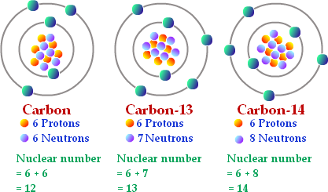
The carbon element has three isotopes having the same atomic number of 6 but different mass numbers of 12,13 and 14. the three isotopes of carbon can be written as
12
C
13
14
C
C
6
6
6

Slide 58
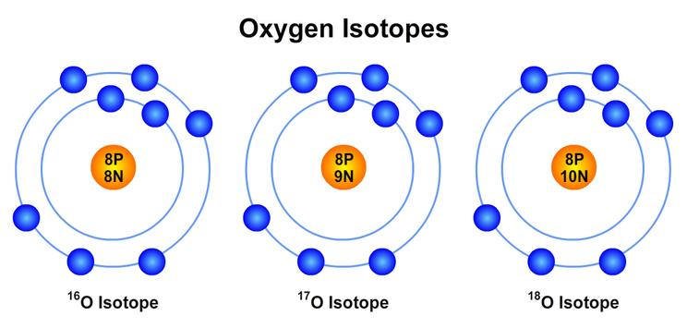
All the isotopes of oxygen have the same atomic number of 8 but they have different mass numbers (or atomic masses) of 16,17 and 18 respectively.
The various isotopes
of an element can
have slightly different
physical properties
such as densities,
melting points and
boiling points.
16
O
17
18
8
O
O
8
8
Since the masses of the isotopes of an element are slightly
different, therefore, the physical properties of the isotopes
of an element are slightly different.

Slide 59
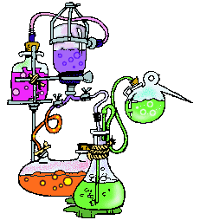
It is obvious from the above symbols that all the isotopes of neon have the same atomic number of 10 but they have different mass numbers (or atomic masses) of 20,21 and 22 respectively.
20
Ne
21
Ne
22
Ne
Isotopes of Neon
10
10
10
The chemical properties of an atom of the element
depend on the number of proton and electrons, not on
the number of neutrons.
The chemical
properties of all the
isotopes of an element
are identical (or same).
Since all the isotopes
of an elements
contain the same number of
proton and electrons.

Slide 60
MODULE : 13
Isobars

Slide 61

35
The chlorine isotope Cl
has a mass of 35 u and its
abundance ( or proportion)
in nature is 75%
17
37
The chlorine isotope Cl
has a mass of 37 u and its
abundance ( or proportion)
in natural is 25%
17

Slide 62

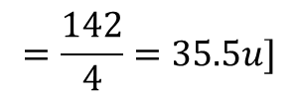
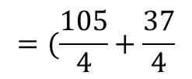
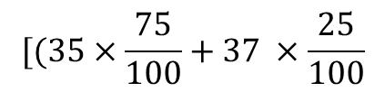
The average atomic mass of chlorine atom.
On the basic of above data.
Solution
$$[(35×\frac{75}{100}+37 ×\frac{25}{100}$$
$$=(\frac{105}{4}+\frac{37}{4}$$
$$=\frac{142}{4}=35.5u]$$
This does not mean that any one atom of chlorine has a fractional mass of 35.5 u.
It mean that if you take a certain amount of
chlorine, it will contain both isotopes of
chlorine and the average mass is 35.5 u.

Slide 63
Bromine occurs in nature mainly in the form of 2 isotopes Br and
Br. If the abundance of Br isotope is 49.7% and that of Br
isotope is 50.3%, calculate the average atomic mass of bromine.
79
79
35
81
81
35
35
35
Solution
We know that upper digit in the symbol of an isotope represents its mass ( which is the same as its mass number). Now:
The mass of Br isotope is 79 u and its abundance is 49.7%
The mass of Br isotope is 81 u and its abundance is 50.3%
79
35
81
35

Slide 64
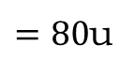
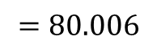
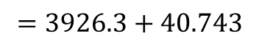
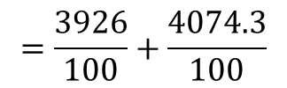
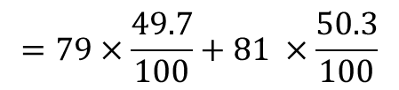
$$=79×\frac{49.7}{100}+81 ×\frac{50.3}{100}$$
$$=\frac{3926}{100}+\frac{4074.3}{100}$$
$$=3926.3+40.743$$
$$=80.006$$
$=80$u
Thus the average atomic mass of bromine is 80 u.

Slide 65
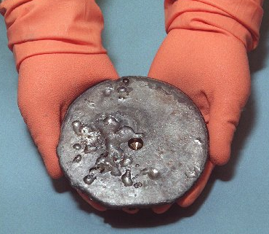
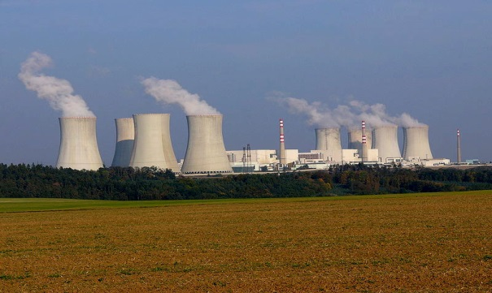
`
Applications of Radioactive Isotopes
Uranium
Uranium-235 (²³⁵U) is
used for nuclear
fission and Production
of energy.
Isotopes of some elements are used in the medical treatment of deadly disease like cancer.
Nuclear power plant

Slide 66


`
Applications of Radioactive Isotopes
Iodine (¹³¹I) is used in the treatment of GOITRE a disease
of thyroid gland

Slide 67
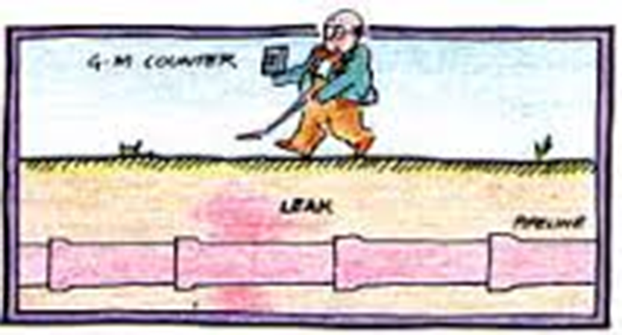
`
Applications of Radioactive Isotopes
Radioactive isotopes are used
in industry to detect the
Leakage in underground oil
Pipelines, gas pipelines
and water pipe

Slide 68
14

Slide 69
`
ISOBARS
Let us consider
two elements
Atoms of different elements having different atomic number but same atomic mass number
Mass number
Examples
Isobar
Protons
Neutrons
Argon (Ar)
18
22
40
Calcium (Ca)
20
20
40

Slide 70

Which two of the following
atomic species are isotopes
of each other and which
two are isobars??
231
Z,
230
Z,
230
Z,
233
90
91
88
90
Z
Solution
The isotopes of an element have the same atomic number
but different mass numbers. The lower figure in the above
given symbols indicate the atomic numbers. Now, in this
case there are two atoms having the same atomic number
of 90. so, the two isotopes will be:

Slide 71
231
Z,
and
233
Z
90
90
(b) The isobars have different atomic numbers but same mass numbers. The upper figures in the given symbols indicate the mass numbers. In this case there are two mass
number of 230. So, the two isobars will be:
230
and
230
Z,
Z
91
88

Slide 72


